Slide 1
ATAI
Advanced Techniqueof Artificial Intelligence
ATAI
ChongqingUniversity _{AdvancedTechniqueof}
of Technology Artificial Intelligence
Chongqing University of
Technology
Chongqing University ^{ATAI}
_{of Technology} Advanced Techniqueof
Artificial Intelligence
Chongqing University of Technology
Chongqing University of Technology
LLMRec: Large Language Models with Graph Augmentation
for Recommendation
Code: https://github.com/HKUDS/LLMRec
2024.10.31•ChongQing
—— WSDM 2024
Reported by Jinfei Chen
1

Slide 2
ATAI
AdvancedTechniqueof
Artificial Intelligence
ATAI
ChongqingUniversity _{AdvancedTechniqueof}
of Technology Artificial Intelligence
ChongqingUniversity of Technology
Motivation
The problem of data sparsity has long been a challenge in recommendation systems, and previous studies have attempted to address this issue by incorporating side information. However, this approach often introduces side effects such as noise, availability issues, and low data quality, which in turn hinder the accurate modeling of user preferences and adversely impact recommendation performance.

Slide 3
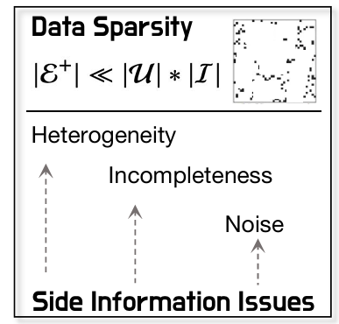
ATAI
AdvancedTechniqueof
Artificial Intelligence
ATAI
ChongqingUniversity _{AdvancedTechniqueof}
of Technology Artificial Intelligence
ChongqingUniversity of Technology
Motivation
Noise：In a micro video recommender, the inclusion of irrelevant textual titles that fail to capture the key aspects of the video’s content introduces noise, adversely affecting representation learning.
Heterogeneity：In the micro recommendation system, movie script data and audience reviews are two common side information sources. Simply combining them while ignoring their differences can impact the accuracy and personalization of recommendations.
incompleteness： items may have incomplete textual descriptions or missing key attributes.

Slide 4
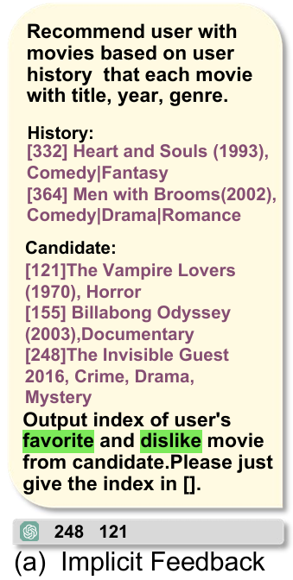
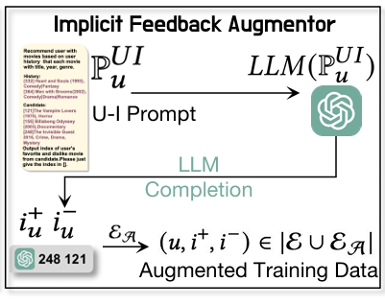
ChongqingUniversity of Technology
ATAI
AdvancedTechniqueof
Artificial Intelligence
ATAI
ChongqingUniversity _{AdvancedTechniqueof}
of Technology Artificial Intelligence
Overview

Slide 5
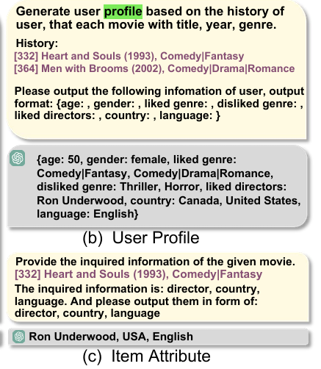
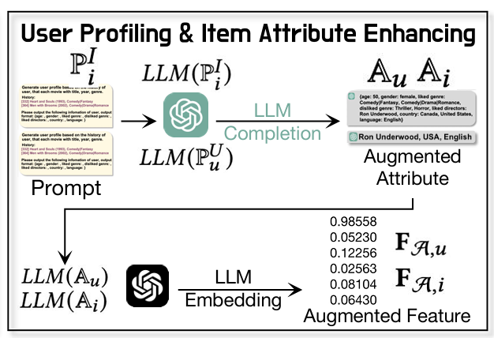
ChongqingUniversity of Technology
ATAI
AdvancedTechniqueof
Artificial Intelligence
ATAI
ChongqingUniversity _{AdvancedTechniqueof}
of Technology Artificial Intelligence
Overview

Slide 6
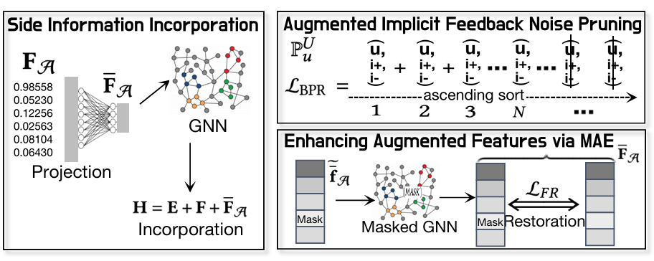
ChongqingUniversity of Technology
ATAI
AdvancedTechniqueof
Artificial Intelligence
ATAI
ChongqingUniversity _{AdvancedTechniqueof}
of Technology Artificial Intelligence
Overview

Slide 7
ChongqingUniversity of Technology
ATAI
AdvancedTechniqueof
Artificial Intelligence
ATAI
ChongqingUniversity _{AdvancedTechniqueof}
of Technology Artificial Intelligence
Method

Slide 8
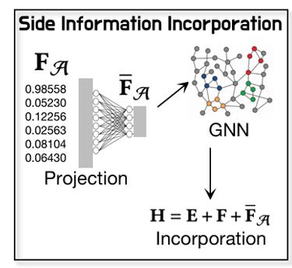
ChongqingUniversity of Technology
ATAI
AdvancedTechniqueof
Artificial Intelligence
ATAI
ChongqingUniversity _{AdvancedTechniqueof}
of Technology Artificial Intelligence
Method

Slide 9
ChongqingUniversity of Technology
ATAI
AdvancedTechniqueof
Artificial Intelligence
ATAI
ChongqingUniversity _{AdvancedTechniqueof}
of Technology Artificial Intelligence
Method

Slide 10
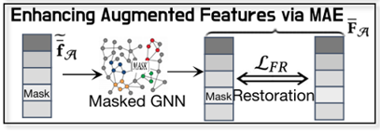
ChongqingUniversity of Technology
ATAI
AdvancedTechniqueof
Artificial Intelligence
ATAI
ChongqingUniversity _{AdvancedTechniqueof}
of Technology Artificial Intelligence
Method

Slide 11
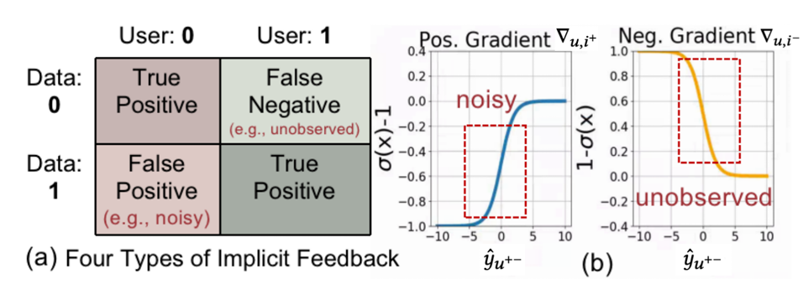
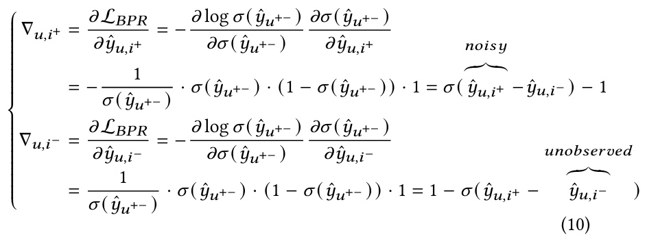
ChongqingUniversity of Technology
ATAI
AdvancedTechniqueof
Artificial Intelligence
ATAI
ChongqingUniversity _{AdvancedTechniqueof}
of Technology Artificial Intelligence
Method

Slide 12
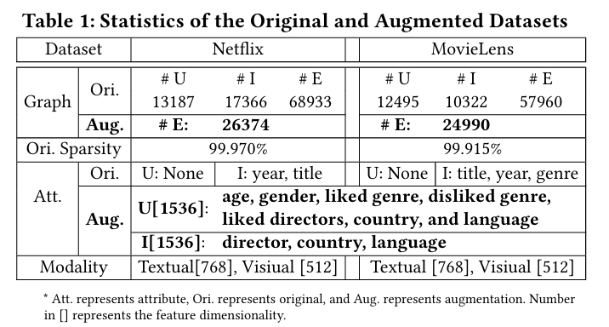
ATAI
AdvancedTechniqueof
Artificial Intelligence
ATAI
ChongqingUniversity _{AdvancedTechniqueof}
of Technology Artificial Intelligence
ChongqingUniversity of Technology
Experiments

Slide 13
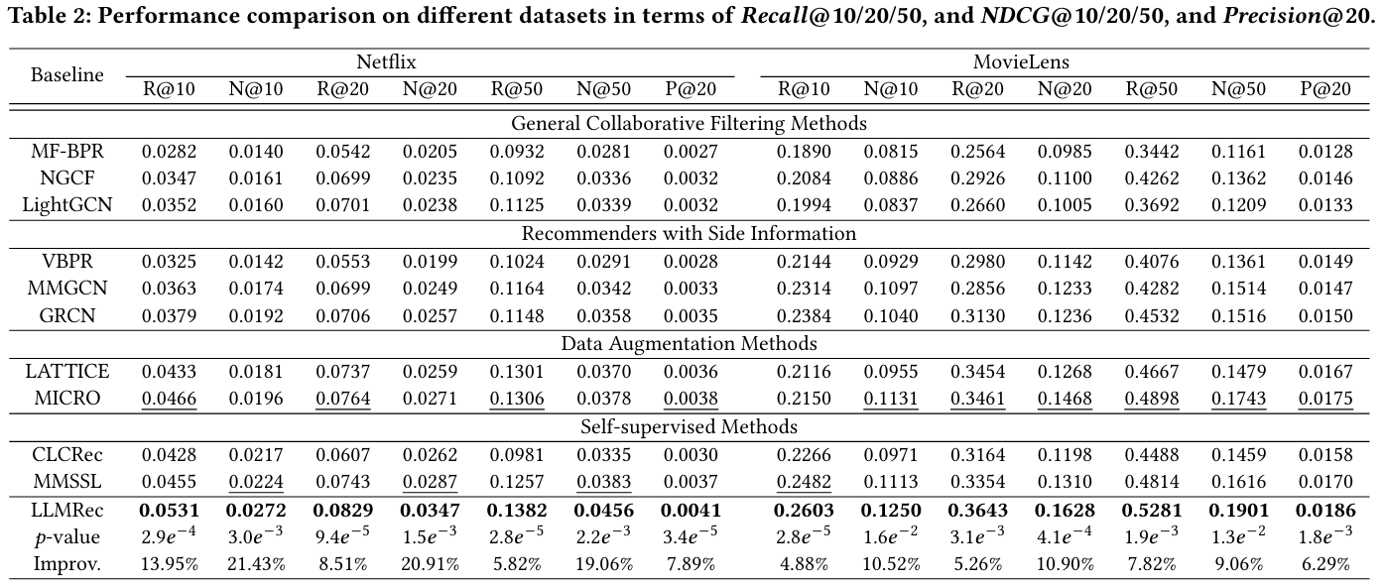
ATAI
AdvancedTechniqueof
Artificial Intelligence
ATAI
ChongqingUniversity _{AdvancedTechniqueof}
of Technology Artificial Intelligence
ChongqingUniversity of Technology
Experiments

Slide 14
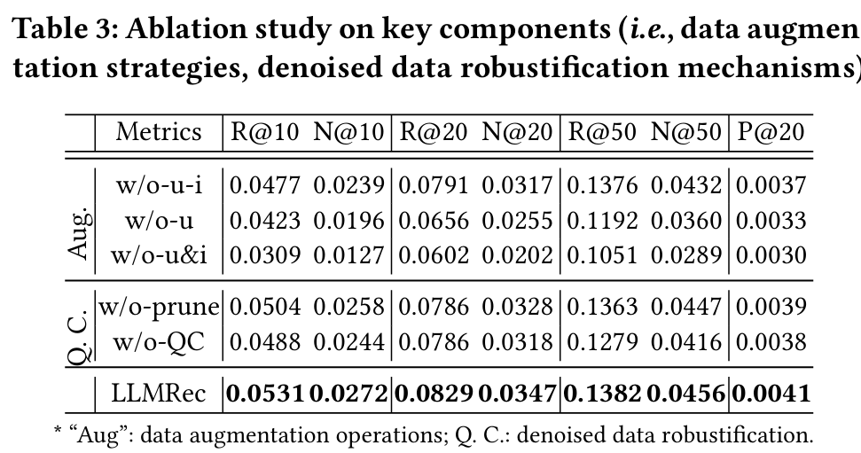
ATAI
AdvancedTechniqueof
Artificial Intelligence
ATAI
ChongqingUniversity _{AdvancedTechniqueof}
of Technology Artificial Intelligence
ChongqingUniversity of Technology
Experiments

Slide 15
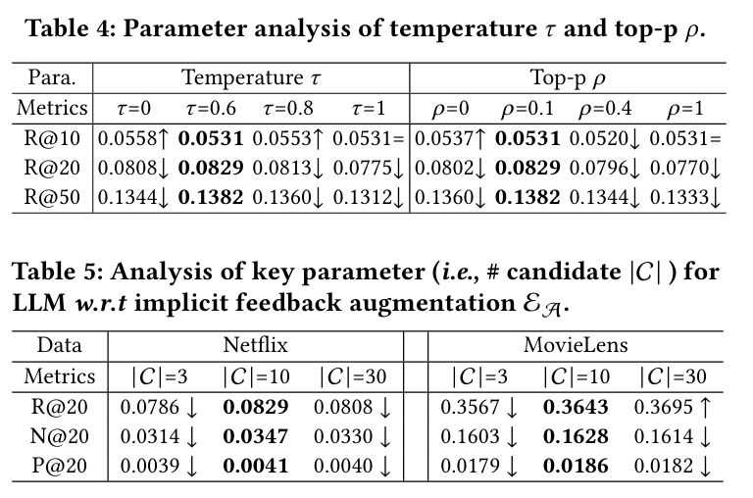
ATAI
AdvancedTechniqueof
Artificial Intelligence
ATAI
ChongqingUniversity _{AdvancedTechniqueof}
of Technology Artificial Intelligence
ChongqingUniversity of Technology
Experiments

Slide 16
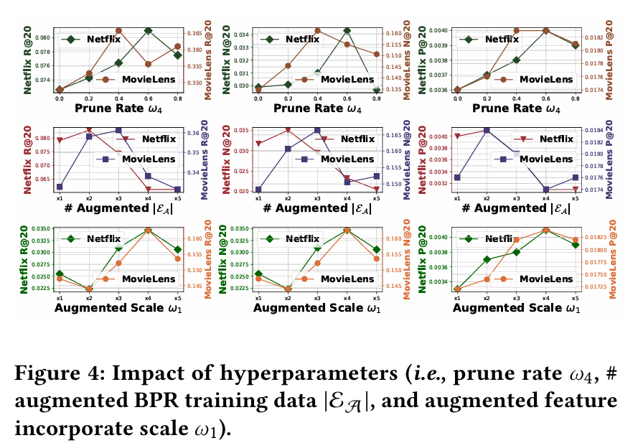
ATAI
AdvancedTechniqueof
Artificial Intelligence
ATAI
ChongqingUniversity _{AdvancedTechniqueof}
of Technology Artificial Intelligence
ChongqingUniversity of Technology
Experiments

Slide 17
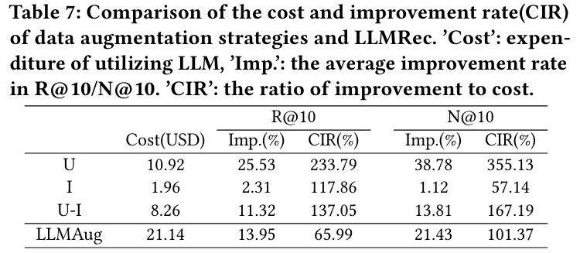
ATAI
AdvancedTechniqueof
Artificial Intelligence
ATAI
ChongqingUniversity _{AdvancedTechniqueof}
of Technology Artificial Intelligence
ChongqingUniversity of Technology
Experiments

Slide 18
ChongqingUniversity of Technology
ATAI
AdvancedTechniqueof
Artificial Intelligence
ATAI
ChongqingUniversity _{AdvancedTechniqueof}
of Technology Artificial Intelligence
Thanks!

